Slide 1
Consumer Behaviour:
How and Why We Buy
Chapter Four

Slide 2
Chapter Objectives
Define consumer behavior and explain the purchase decision-making process
Explain how internal factors influence consumers’ decision-making processes
Show how situational factors and consumers’ relationships with other people influence consumer behavior
Copyright © 2013 Pearson Canada Inc.
4-<number>
Notes:
p. 120
LECTURE NOTES:
After finishing this chapter, you should be able to:
1. Define consumer behavior and explain the purchase decision making process.
2. Explain how internal factors influence consumers’ decision-making processes.
3. Show how situational factors and consumers’ relationships with other people influence consumer behavior.

Slide 3
I. Define consumer behavior and explain the purchase decision-making process
Copyright © 2013 Pearson Canada Inc.
4-<number>
Notes:
This slide relates to Learning Objective (hereafter LO) #1 of chapter 4.

Slide 4
The Consumer Decision-Making Process
Consumer behavior
The process we use to select, purchase, use, and dispose of goods, services, ideas, or experiences to satisfy needs/desires
Internal, situational, and social factors influence consumer behavior
Copyright © 2013 Pearson Canada Inc.
4-<number>
Notes:
This slide relates to LO #1 of chapter 4.
p. 120
LECTURE NOTES:
In order to execute the marketing concept, marketers must understand the needs of consumers. Studying consumer behavior – the process used by consumers to select, purchase, use and dispose of items that satisfy their needs is essential for this reason.
Understanding how and when goods are consumed is also important. For example, if consumer’s of a particular brand cereal primarily use that product as a dry snack, as opposed to a true breakfast product, the marketing communications strategy would want to reflect that usage in TV advertising and other communications.
As the goal of marketing is to influence consumer behavior, understanding the internal, situational and social factors which influence behavior is also important, as each of these factors represent opportunities for customizing the marketing mix in a way that will most appeal to consumers.

Slide 5
Not All Decisions Are the Same
Decisions vary in terms of the amount of effort people put into decision making
  Habitual decision making
  Limited problem solving
  Extended problem solving
Amount of effort increases when
  Involvement is high
  Perceived risk is high
Copyright © 2013 Pearson Canada Inc.
4-<number>
Notes:
This slide relates to LO #1 of chapter 4.
p. 121
LECTURE NOTES:
Think about the process you (or your parents) used to purchase your last car, and compare it the process which guided your decision the last time you decided to eat out at a restaurant. Did you spend an equal amount of time and effort on both of these tasks? Of course not!
Consumer decision-making varies in the amount of the time and effort expended, and is probably best thought of as spanning a continuum anchored by habitual decision-making on one end, and extended problem-solving on the other end, with limited problem solving sitting in the middle.

Slide 6
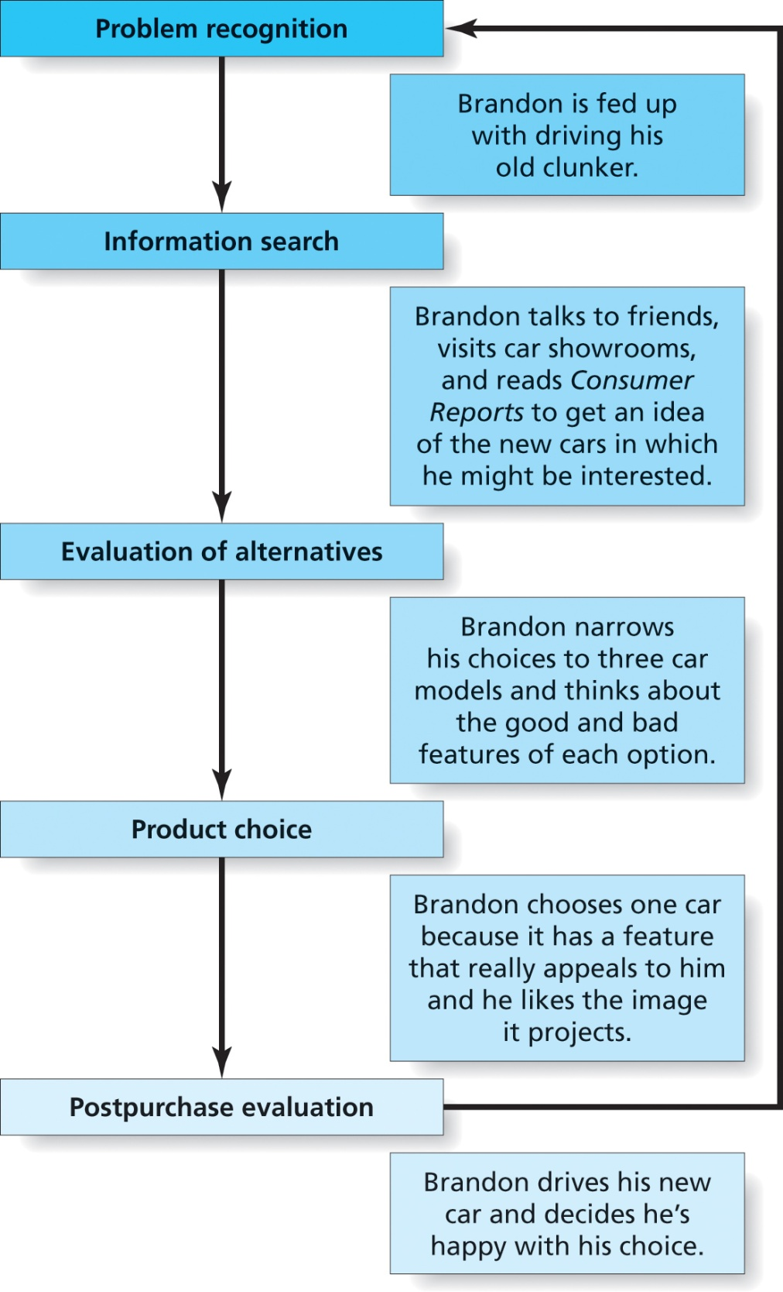
Figure 4.1
The Consumer Decision-Making Process
Copyright © 2013 Pearson Canada Inc.
4-<number>
Notes:
This slide relates to LO #1 of chapter 4.
p. 122
LECTURE NOTES:
Consumers who engage in extended problem-solving follow each of the steps outlined in the consumer-decision making process: problem recognition, information search, evaluation of alternatives, product choice, and post purchase evaluation. On the other end of the scale, routine purchases (milk, soft drinks, eggs) are often habitual in nature requiring little if any conscious effort on the part of the consumer. Of course quite a few decisions are characterized by limited problem-solving, rules of thumb may be used to help make a decision (ask a friend for recommendations, only consider well-known brands, etc.)

Slide 7
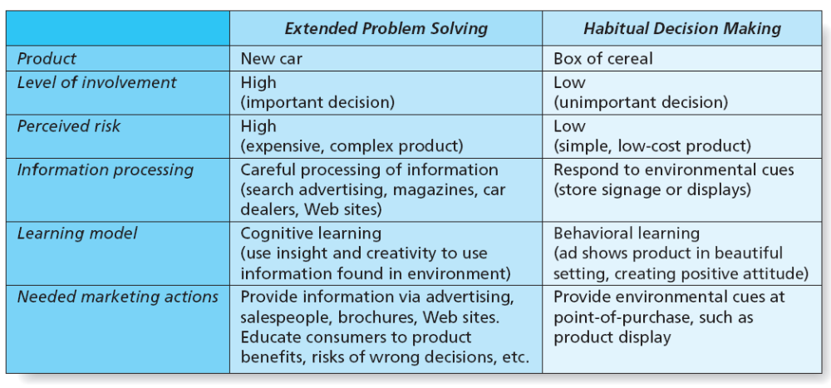
Figure 4.2
Extended Problem Solving vs. Habitual Decision Making
Copyright © 2013 Pearson Canada Inc.
4-<number>
Notes:
This slide relates to LO #1 of chapter 4.
p. 122
LECTURE NOTES:
The amount of effort devoted by consumers to buying decisions varies according to the level of involvement – how important the decision is perceived to be by consumers.
The level of perceived risk correlates strongly with involvement – the more expensive the product or the more complex it is, the higher the level of perceived risk. The higher the consequences of making a wrong choice, in terms of embarrassment, social rejection, the higher the level of perceived risk.
Consumers are more likely to spend a great deal of time in the decision making process, carefully collecting and processing all of the available information when involved in extended problem solving. This is because the consequences of the purchase are important and risky, as the wrong choice could result in significant financial loses, embarrassment, or other negative outcomes. The opposite, of course, is true for habitual decision making.
Understanding the type of decision making that guides the majority of the target market’s choice is important, as it suggests differing tactics that marketers should use to appeal to consumers, as shown on this slide.

Slide 8
Step 1: Problem Recognition
Occurs whenever the consumer sees a significant difference between his/her current state and the desired/ideal state
This recognition initiates the decision-making process
To stimulate problem recognition, marketers develop ads to encourage consumers to see that existing state does not equal desired state
Copyright © 2013 Pearson Canada Inc.
4-<number>
Notes:
This slide relates to LO #1 of chapter 4.
p. 123
LECTURE NOTES:
Let’s discuss the consumer decision-making process in more detail. The first step is problem recognition.
Problem recognition occurs whenever the consumer sees a significant difference between his/her current state and the desired/ideal state. It’s the recognition that a problem exists which prompts the consumer to begin looking for a solution.
While most problem recognition occurs spontaneously as needs arise, marketers can develop ads that attempt to stimulate problem recognition. For example, this Campbell’s Soup ad asks, “What shape are your kids in?”, attempting to quick-start problem recognition for parents who may need to consider they feed their kids.
DISCUSSION NOTE:
Ask students for other examples of how marketers stimulate problem recognition.
Example: radio ads promoting restaurants which are played at lunchtime (scheduling ads at relevant time)
Example: TV ad showing excitement of owning a new car, or envy of a neighbor (may create dissatisfaction with current vehicle)

Slide 9
Inclass Activity
Sometimes advertising or other marketing activities cause problem recognition by showing consumers how much better off they would be with a new product or by pointing out
problems with products they already own. Discuss problem recognition for the following product categories. Make a list of some ways marketers might try to stimulate problem
recognition for each product. Present your ideas to your class.
a. Life insurance
b. Mouthwash
c. A new automobile
d. A health club membership
Copyright © 2013 Pearson Canada Inc.
5-<number>

Slide 10

Step 2: Information Search
Is a process whereby a consumer searches for appropriate information to make a reasonable decision
Consumers increasingly rely on Internet for information search
  www.google.com
  www.edmunds.com
  www.shopzilla.com
Copyright © 2013 Pearson Canada Inc.
4-<number>
Notes:
This slide relates to LO #1 of chapter 4.
p. 123
LECTURE NOTES:
Following problem recognition, an individual engaged in extended or limited problem solving will engage in information search to at least some degree.
Consumers are increasingly turning to the Internet as a quick and effective method of finding information about products.
EDMUNDS.COM
This site may be worth visiting as an example of the depth and breadth of information available on the web. Edmunds.com provides information on current manufacturer incentives and rebates, as well as dealer price for cars consumers can “build” from scratch. Reviews are also provided, and though not a true shopping bot, Edmunds does make it easy for consumers to get price quotes from local dealers, based on the zip code information provided.

Slide 11
Internet as a Search Tool
Marketers now use more specialized search marketing techniques
Search engine optimization (SEO)
    A systematic process of ensuring that your firm comes up at or near the top of lists of typical search phrases related to your business
Search engine marketing (SEM)
    Search marketing strategy in which marketers pay for ads or better positioning
Copyright © 2013 Pearson Canada Inc.
4-<number>
Notes:
This slide relates to LO #1 of chapter 4.
p. 124
LECTURE NOTES:
Consumers are increasingly turning to the Internet as a quick and effective method of finding information about products. Search engines such as Google locate potential web sites of interest; unfortunately for marketers, their web page may be buried among the millions of pages found.
As a result, many marketers are now using more specialized search marketing techniques. Investments in search engine optimization (SEO) require that marketers 1) determine what key words consumers use most in their searches and 2) alter their web site’s content and HTML code in a way that allows the page to appear higher on the list of search results returned by the consumer’s query.
Still, there’s only so much room at the top of the search result list, and most consumers never venture beyond the first two pages of search results. Thus many marketers are supplementing their marketing efforts with investments in search engine marketing (SEM).
In search engine marketing, marketers bid on key words searched by consumers for the right to display a “sponsored ad” at the top or right hand side of natural search results.

Slide 12
Behavioural Targeting
Is the marketing practice by which marketers deliver advertisements for products a consumer is looking for by watching what the consumer does online
Audience Science’s Behavioral Targeting
Copyright © 2013 Pearson Canada Inc.
4-<number>
Notes:
This slide relates to LO #1 of chapter 4.
p. 125
LECTURE NOTES:
Behavioral targeting is a technique that customizes the ads shown on the Internet based on the user’s surfing and browsing habits. Also known as audience-based advertising. While not widespread, some TV cable systems also allow marketers to use behavioral targeting to reach individuals based on certain demographic data, such as income, ethnicity, gender, and household size.
NOTE TO INSTRUCTOR:
The best way to easily explain and demonstrate behavioral targeting to visit the www.audiencescience.com website and play the “Consumer’s guide to audience based advertising” video, which is linked to the graphic and text on this slide.

Slide 13
It’s Debatable
Class Discussion Question
Most consumers agree that using demographic information for targeting purposes is acceptable, but critics contend that tracking users browsing and surfing behavior crosses the line.
What do you think? Should stronger controls be in place to protect consumers privacy?
Copyright © 2013 Pearson Canada Inc.
4-<number>
Notes:
This slide relates to LO #1 of chapter 4.
DISCUSSION NOTES:
It might be beneficial to remind students that cookies, which are at the heart of behavioral targeting, can be manually deleted, or even blocked by many software programs. Thus it could be argued that consumers have the control necessary to block behavioral targeting if they so desire.
It could also be argued that behavioral targeting provides a superior web browsing experience, because it ultimately enhances the relevancy of the ads that they see as part of their browsing experience.
On the other side of the coin, there is cause for concern if the providers of behavioral targeting services do not protect the anonymity of respondents. In this case, names or other personally identifiable information can be linked to behavior. It might be beneficial to ask students to think through WHY and HOW behavioral targeting could be detrimental. According to a November 6, 2010 report by Sarah Kessler of ABC News (http://abcnews.go.com/Technology/online-behavior-tracking-privacy-worst-case-scenarios/story?id=12068346), the following aspects may be cause for concern:
According to an August 2010 study, a substantial portion of consumers (49%) don’t understand that their web behavior is being tracked frequently tracked and believe that their online activities are anonymous.
A lack of regulation concerning what data can, and cannot be tracked and sold could allow some firms to cross the line.
Privacy solutions require users to opt OUT, not IN, and users rarely notice the opt out opportunity or do so. This is complicated by the fact that many people do not realize they are being tracked to begin with.
However, if privacy solutions were to require opting IN by consumers, it would kill the ad industry, and handicap US firms competing globally with those who are unencumbered by US privacy legislation.
Furthermore, since advertising supports much of the content found on the web, the end result could be detrimental to consumers.

Slide 14
Step 3: Evaluation of Alternatives
Identifying a small number of products for further consideration
Evaluating alternatives using evaluative criteria
    Evaluative criteria: The dimensions consumers use to compare competing product alternatives
Copyright © 2013 Pearson Canada Inc.
4-<number>
Notes:
This slide relates to LO #1 of chapter 4.
p. 125 - 126
LECTURE NOTES:
During the third step of the consumer decision making process, a consumer will identify a small number of products in which he or she is interested (called the consideration set), then narrow these choices by comparing the pros/cons of each on the basis of evaluative criteria.
Evaluative criteria are product characteristics which consumers use to compare competing alternatives .Marketers also need to identify and communicate important evaluative criteria to buyers.
For example, a person who is dieting will consider only low-calorie options – a small number of products that will be subjected to additional consideration. Since each product remaining in the consideration set is already low calorie, TASTE may become the ultimate evaluative criteria that helps the consumer decide which low-calorie option is chosen.

Slide 15
Step 4: Product Choice
Decide on one product and act on this choice
Consumers often rely on heuristics to make decisions
    Heuristics: A mental rule of thumb that leads to a speedy decision, by simplifying the process
      Price = quality
      Brand loyalty
      Country-of-origin
Copyright © 2013 Pearson Canada Inc.
4-<number>
Notes:
This slide relates to LO #1 of chapter 4.
p. 126
LECTURE NOTES:
Choosing which product to purchase and acting on that choice is the next step of the consumer decision making process.
Many consumers rely on mental rules of thumb, called heuristics, to help them make decisions.
For example, some people buy the more expensive brand option, believing that the higher price reflects better quality. Others simplify decision making by purchasing the same brand over and over, so long as it continues to satisfy their needs. Finally, some people assume products have certain characteristics if they come from a particular country (Germany – fine engineering, superior chocolate).

Slide 16
Step 5: Postpurchase Evaluation
Consumer satisfaction/dissatisfaction after purchase of product is critical
  Satisfaction is determined by how well a product meets or exceeds expectations
  Marketing communications must create accurate expectations for the product
  Cognitive dissonance is common
    Cognitive dissonance: The anxiety or regret a consumer may feel after choosing from among several similar attractive choices
Copyright © 2013 Pearson Canada Inc.
4-<number>
Notes:
This slide relates to LO #1 of chapter 4.
p. 127
LECTURE NOTES:
The last step of the decision making process is the one in which consumers evaluate how good a choice was made by comparing the expectations they formed regarding the product with its actual performance.
If the benefits and experience delivered exceed expectations, customers are satisfied, but when advertising overpromises what the product can do, or consumers form unrealistic expectations through other means, dissatisfaction will occur.
Cognitive dissonance is common following a major purchase, even in instances where consumers are satisfied with their purchase. Cognitive dissonance refers to the anxiety or regret that a consumer may feel after choosing from among several similar attractive choices. Essentially, consumers become nervous and second guess the choice they made.

Slide 17
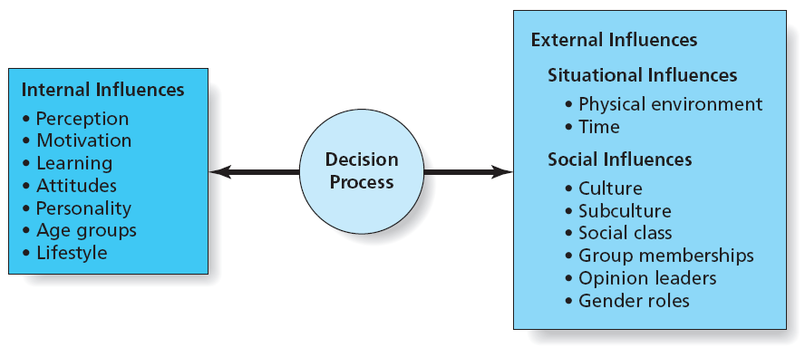
Figure 4.4
Influences on Consumer Decision Making
Copyright © 2013 Pearson Canada Inc.
4-<number>
Notes:
This slide relates to LO #1 and # 2 of chapter 4.
p. 128
LECTURE NOTES:
Marketers also try to understand the influence of each of the factors shown here, and how they impact the decision making process. These include factors internal to the consumer, situational influences, and social influences.

Slide 18
II. Explain how internal factors influence consumers’ decision-making processes
Copyright © 2013 Pearson Canada Inc.
4-<number>
Notes:
This slide relates to LO #2 of chapter 4.

Slide 19
Perception
Perception
  Process by which we select, organize, and interpret information from outside world
Perception involves three issues
    Exposure: The extent to which a stimulus is capable of being registered by a person’s sensory receptors
    Attention: The extent to which a person devotes mental processing to a particular stimulus
    Interpretation: The process of assigning meaning
    to a stimulus based on prior associations and assumptions
Copyright © 2013 Pearson Canada Inc.
4-<number>
Notes:
This slide relates to LO #2 of chapter 4.
p. 128 - 130
LECTURE NOTES:
Multiple internal factors cause individual consumers to interpret information about the outside world differently, including perception.
Perception is the process by which we select, organize, and interpret information form the outside world. Information is received from our visual, aural, and tactile senses and then interpreted in light of our past experiences, or lack thereof.
Obviously marketers want consumers to perceive messages in the manner in which they were intended. For this to occur, consumers must be exposed to the message; they must pay attention to the message by mentally processing the information and cues it contains; and finally, they must interpret the message correctly by assigning the proper meaning to the words and symbols it contains.

Slide 20
Motivation
Motivation
  An internal state that drives us to satisfy needs by activating goal-oriented behaviour stimulus
Maslow’s hierarchy of needs is an influential approach to motivation
Copyright © 2013 Pearson Canada Inc.
4-<number>
Notes:
This slide relates to LO #2 of chapter 4.
p. 130
LECTURE NOTES:
Motivation is an internal state that drivers consumers to satisfy their needs. Understanding what motivates consumers can help marketers do a better job of segmenting the market, and communicating with their chosen target.
For example, marketers at the beginning of the walking shoe craze assumed that all recreational walkers were just burned-out joggers. Subsequent psychographic research that examined the AIOs of these walkers showed that there were actually several psychographic segments within the larger group who engaged in the activity for very different reasons. These different motivations included walking for fun, walking to save money, and walking for exercise. This research resulted in walking shoes for different segments, from Footjoy Walkers to Nike Healthwalkers.

Slide 21
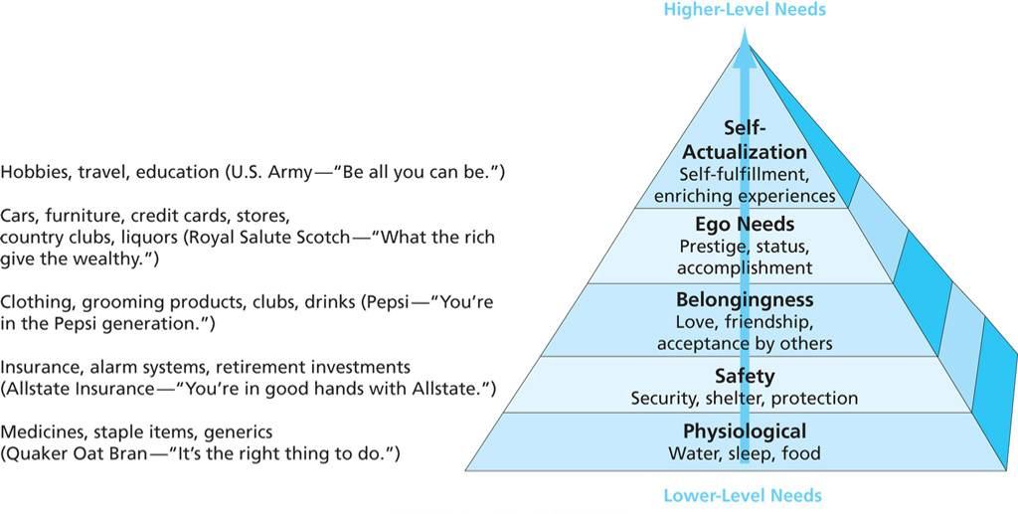
Figure 4.5
Maslow’s Hierarchy of Needs and Related Products
Copyright © 2013 Pearson Canada Inc.
4-<number>
Notes:
This slide relates to LO #2 of chapter 4.
p. 131
LECTURE NOTES:
The hierarchy of needs categorizes motivation as being related to five different types of needs. Need types include physiological, safety, belongingness, ego, and self-actualization. Products and services related to each need level are also shown on the slide.
The basic premise behind the hierarchy of needs is that consumers will seek to satisfy lower level needs (e.g., physiological) before progressing to higher level needs.
When marketers understand the level of need most relevant to their consumer target, they can tailor their product and messages to match.

Slide 22
Learning
Learning
  A relatively permanent change in behaviour caused by information or experience
Learning theories
  Behavioural learning
  Cognitive learning
Copyright © 2013 Pearson Canada Inc.
4-<number>
Notes:
This slide relates to LO #2 of chapter 4.
p. 131 - 132
LECTURE NOTES:
Learning is defined as a relatively permanent change in behavior caused by information or experience. Psychologists have advanced several theories as to how learning occurs.

Slide 23
Behavioural Learning
Behavioural learning theories
    Theories of learning that focus on how consumer behaviour is changed by external events or stimuli
Classical conditioning
    Learning that occurs when a stimulus eliciting a response is paired with another stimulus that initially does not elicit a response on its own but will cause a similar response over time because of its association with the first stimulus
Operant conditioning
    Learning that occurs as the result of rewards or punishments
Copyright © 2013 Pearson Canada Inc.
4-<number>
Notes:
This slide relates to LO #2 of chapter 4.
p. 131 - 132
LECTURE NOTES:
Behavioral learning theories indicate that learning takes place as a result of connections we form between events.
In classical conditioning, a person perceives two stimuli at about the same time. After a while, the person transfers his response from one stimulus to the other. For example, an ad shows a product and a breathtakingly beautiful scene so that (the marketer hopes) you will transfer the positive feelings you get when you look at the scene to the advertised product.
Another common form of behavioral learning is operant conditioning, which occurs when people learn that their actions result in rewards or punishments. This feedback influences how they will respond in similar situations in the future. Just as a rat in a maze learns the route to a piece of cheese, consumers who receive a reward such as a prize in the bottom of a box of cereal will be more likely to buy that brand again.

Slide 24
Cognitive Learning
Cognitive learning theory
    Theory of learning that stresses the importance of internal mental processes and that views people as problem solvers who actively use information from the world around them to master their environment
Observational learning
    Learning that occurs when people watch the actions of others and note what happens to them as a result
Copyright © 2013 Pearson Canada Inc.
4-<number>
Notes:
This slide relates to LO #2 of chapter 4.
p. 132
LECTURE NOTES:
Cognitive learning theory views people as problem-solvers who do more than passively react to associations between stimuli. Cognitive learning takes place when consumers make a connection between ideas or by observing things in their environment.
Observational learning occurs when people watch the actions of others and note what happens to them as a result. This is why many TV ads show the product being used, and the positive benefits that result from that usage.

Slide 25
Attitudes
  Lasting evaluations of a person, object, or issue
  It is a predisposition to act favourably or unfavourably to stimuli
Three attitude components
    Affect (feeling): emotional response
    Cognition (knowing): beliefs or knowledge: knowledge a person has about a product, its key benefits and features e.g mkters provide factual information about products
    Behaviour (doing): intention to do something: e.g car ad that invite viewers to take a test drive
Copyright © 2013 Pearson Canada Inc.
4-<number>
Notes:
This slide relates to LO #2 of chapter 4.
p. 132
LECTURE NOTES:
Marketers often attempt to influence consumer’s attitudes toward brands or the ads themselves. Attitudes are learned predispositions to respond favorably or unfavorably to stimuli on the basis of relatively enduring evaluations of people, objects, and issues.
A person’s attitude is composed of three components:
Affect (feeling component): The overall emotional response that a person has to a product. The affective component of attitude is usually dominant for the types of product that make us happy – perfume, jewelry, certain types of food, entertainment, etc.
Cognition (knowing component): The beliefs or knowledge that a person has related to the product and its key features and benefits. Marketers often appeal to the cognitive component of attitude by providing factual information, especially for complex products or for those in which consumers are highly involved in the decision making process.
Behavior (doing component): this component of attitude relates to an individual’s intention to do something, such as to try or buy the product. A car ad which invites viewers to take a test drive is attempting to stimulate this component of attitude.

Slide 26
Personality and the Self
Personality
The set of unique psychological characteristics that consistently influences the way a person responds to situations in the environment
  Consumers buy products that are extensions of their personalities
  Marketers create brand personalities to appeal to different types of people
Self-concept
  An individual’s self-image that is composed of a mixture of beliefs, observations, and feelings about personal attributes
Copyright © 2013 Pearson Canada Inc.
4-<number>
Notes:
This slide relates to LO #2 of chapter 4.
p. 133
LECTURE NOTES:
Personality is simply defined as the set of unique psychological characteristics that consistently influences the way a person responds to situations in the environment. Understanding personality can help marketers create brands that appeal to specific personality types.
Self-concept refers to the attitude that an individual has toward himself. A person’s self-concept can influence the products he or she purchases. For example, this German ad appeals directly to the self-concepts of potential customers who want to lose weight.

Slide 27
Age
Age
  Goods/services often appeal to a specific age group
  Purchases are often associated with a particular stage in the family life cycle
  Name some products that can be successfully marketed on the basis of age or stage in the family life cycle: e.g. furniture
Copyright © 2013 Pearson Canada Inc.
4-<number>
Notes:
This slide relates to LO #2 of chapter 4.
p. 133
LECTURE NOTES:
Many products and the corresponding marketing strategies appeal to the needs of different age groups, babies, children, young adults, the middle-aged, and elderly. Name some examples! {Elderly: retirement homes, assisted living; Children: Toys, learning aids, etc.}.
While age is important, some product categories are better segmented on the basis of family life cycle – the stage through which family members pass they grow older. What are some examples?? {Furniture – college students buy cheap, easy to assemble furniture; married couples with newborns need cribs; middle-aged individuals may upgrade their furniture to nicer quality items once the children are out of the house; Elderly may need to replace their beds and mattresses with alternatives that making sleeping easier, such as Sleep by Number beds, or Tempur-pedic mattresses.

Slide 28
Lifestyle
A Lifestyle is a pattern of living
Consumers choose products that they associate with a certain life style
Marketers group consumers according to psychographics
    Psychographics: The use of psychological, sociological, and anthropological factors to construct market segments
Marketers seek to describe people according to activities, interests, and opinions (AIOs)
Copyright © 2013 Pearson Canada Inc.
4-<number>
Notes:
This slide relates to LO #2 of chapter 4.
p. 133 – 134
LECTURE NOTES:
Lifestyles reflect a pattern of living that determines how people choose to spend their time, money, and energy. For this reason, marketers try to describe target segments by lifestyle, and according to their activities ,interests, and opinions.
Psychographics are used to profile, or group consumers according to these psychological and behavioral similarities. This allows marketers to not only target products more effectively, but also to better communicate with targeted segments by reflecting the unique interests, activities, and lifestyles of the targeted group in marketing communications.

Slide 29
BAB235 - In class Activity
Assume that you are in the marketing department of a manufacturer of one of the products
listed below. You know that internal factors including (1) perception, (2) motivation, (3)
learning, (4) attitudes, and (5) personality, age and lifestyle influence consumers’ decision making. With your
classmates, develop your ideas about why each of these internal factors is important in the
purchase of the following products and how you might use these factors in developing marketing
strategies for your firm. Report your ideas to your class.
a. Automobiles
b. Designer jeans
c. An iPad or other tablet book
d. Fragrances (for men or for women)
e. Furniture
Copyright © 2013 Pearson Canada Inc.
5-<number>

Slide 30
III. Show how situational factors and consumers’ relationships with other people influence consumer behavior
Copyright © 2013 Pearson Canada Inc.
4-<number>
Notes:
This slide relates to LO #3 of chapter 4.

Slide 31
Situational Influences
Situational factors (i.e., when, where, and how consumers shop) shape purchase choices
  Sensory marketing is becoming big business
  Physical environment strongly influence people’s moods and behaviours
    Arousal and pleasure determines whether a shopper will react positively or negatively to a store environment
  The sense of time poverty makes consumers respond positively to marketing innovations that allow them to save time
Copyright © 2013 Pearson Canada Inc.
4-<number>
Notes:
This slide relates to LO #3 of chapter 4.
p. 134 - 136
LECTURE NOTES:
Situational factors such as the physical environment in which we shop, and time pressures help to share our purchase choices.
Within the physical environment, store décor, smells, lighting, music and temperature can influence consumption, which explains why sensory marketing is such big business. Sensory marketing occurs when a direct sensory experience, such as a unique fragrance, is linked with a particular product or service.
Two factors, arousal and pleasure determine consumers’ reaction to store environment. When the store surrounding is exciting (arousing), reactions are likely to be pleasant, while dull surrounds that do not arouse the consumer and are more likely to stimulate less than pleasant reactions.
Time is one consumers’ most limited resources and this sense of time poverty makes consumers more likely to respond to marketing services and products that offer to save time (1 hour film processing, music downloads over the web vs. ordering a CD for delivery, etc.).

Slide 32
Social Influences on Consumers’ Decisions
Culture: The way of life of a society that is passed on from generation to generation, it is society’s personality
The values, beliefs, customs, and tastes produced or practiced by a group of people
Includes key rituals like weddings and funerals
Rituals are associated with specific products
Marketers tailor products to cultural values
Copyright © 2013 Pearson Canada Inc.
4-<number>
Notes:
This slide relates to LO #3 of chapter 4.
p. 136 - 137
LECTURE NOTES:
Culture is the society’s personality.
Rituals also vary by culture, be they weddings, funerals, or holiday celebrations. Thanksgiving is a unique North American holiday typically celebrated with Turkey, dressing, cranberry sauce, and pumpkin pie. Understanding key rituals within a culture is important because these represent opportunities to demonstrate how a brand fits within the culture.

Slide 33
Subcultures
  A group within a society whose members share a distinctive set of beliefs, characteristics, or common experiences e.g. people who share the same religion or ethnicity
  Microcultures
    Groups of consumers who identify with a specific activity or art form
What other examples of microcultures can you think of? – Snowboarder
Copyright © 2013 Pearson Canada Inc.
4-<number>
Notes:
This slide relates to LO #3 of chapter 4.
p. 137
LECTURE NOTES:
Subcultures are groups within a society who share a distinctive set of beliefs, characteristics, or common experiences. Examples of subcultures include people who share the same ethnic background or the same religion.
An even more specific form subculture are those who identify with a specific activity or art form. These groups of individuals are referred to as microcultures. A great example of a microculture are the HOGS – members of the Harley Davidson Owners Group.
DISCUSSION NOTE:
Other examples of microcultures include macophiles (those who are intensely devoted to and interested in the Macintosh computer brand), brand groupies, snowboarders, and many others.

Slide 34
Emerging Lifestyle Trends
Consumerism
  A social movement that attempts to protect consumers from harmful business practices
  Consumer Watchdog
  http://www.consumerwatchdog.org/ Consumerist; Criticisms from consumerists can be especially damaging i.e. marketers should adopt good business practices
Copyright © 2013 Pearson Canada Inc.
4-<number>
Notes:
This slide relates to LO #3 of chapter 4.
p. 137 - 138
LECTURE NOTES:
Consumerism refers to current attempts to protect consumers from harmful business practices. For example, public outcry in response to the use of the “cool” cartoon figure, Joe Camel, reached the ears of legislators, who studied the issue and concluded that Joe Camel was appealing to children and teens. As cigarette marketing to minors is against the law, special provisions governing where and how tobacco marketing could be done were included as part of the Tobacco Settlement agreement.
More recently, many consumerists remain concerned about how businesses are using personal information. In response to these criticisms, some laws have been passed, and many marketers are voluntarily imposing limitations on the use of this information.
Watchdog groups such are constantly on the look out for harmful consumer business practices, and often actively promote their agenda to congress. The Consumer Watchdog (http://www.consumerwatchdog.org/) website, and the Consumerist web site (http://consumerist.com/) are two examples of consumerism in action. Take a look at some of home page of the Consumer Watchdog to see this in action.
Criticisms from consumerists can be especially damaging, so marketers best path to maintaining a good image is to be proactive by practicing good business practices.

Slide 35
It’s Debatable
Class Discussion Question
Should cell phone companies and satellite television providers be allowed to require consumers to sign contracts for a minimum period of service?
Should they be allowed to charge consumers for the cost of service on the remaining contract months in the case of early termination?
Should there be exceptions base on circumstances
Copyright © 2013 Pearson Canada Inc.
4-<number>
Notes:
This slide relates to LO #3 of chapter 4.
DISCUSSION NOTES:
This question may spark some interesting comments and even horror stories of students who have been “done wrong”. Most students will argue that their freedom of choice should be respected, and that service contracts and early termination fees are harmful business practices which should be eliminated. It’s likely that few students will see the issue from the perspective of the business.
Businesses such as cell phone, satellite television, and internet service providers incur high customer acquisition costs – for example, TELUS may give new subscribers a very low price for internet service for the first 3 months to entice them away from their current internet provider. Without a “contract”, there’s nothing to stop customers from switching back to a different provider once the freebies have ended. Early termination fees help to recover the revenue lost from those consumers who change their mind after enjoying the new member benefits that enticed them to the service in the first place.
However, it could also be argued that some providers contract requirements are excessive – for example, some satellite internet providers require a 24 month commitment in exchange for loaning the consumer the satellite dish.
Early termination fees are often the result of leaving service providers before a contract has ended. Yet clearly there are circumstances when early termination fees should be suspended – ask students to identify these. (Example: death of consumer; moving abroad, etc.) The difference between when it is appropriate or not appropriate to charge early termination fees may come down to the degree to which the need to drop service is within the consumer’s control. Obviously, a military family that is transferred abroad has no choice but to move, and ideally, should not be penalized for circumstances that are beyond their control.

Slide 36
Emerging Lifestyle Trends (ctn’d)
Environmentalism
  A broad philosophy and social movement that seeks conservation and improvement of the natural environment
    Kyoto Protocol (1997)
  Environmental stewardship
  Concerns about Greenwashing
    GreenwashingIndex.com
Copyright © 2013 Pearson Canada Inc.
4-<number>
Notes:
This slide relates to LO #3 of chapter 4.
p. 138
LECTURE NOTES:
Environmentalism is a broad philosophy and social movement that seeks conservation and improvement of the natural environment.
The Kyoto protocol, for example, covers 170 countries and is aimed at reducing greenhouse gas emissions that could change our climate.
Environmental stewardship refers to the fact that many businesses now recognize the importance of environmentalism, and willing choose to make socially responsible business decisions that protect the environment.
Green marketing includes efforts by marketers to choose packages, product designs, and other aspects of the marketing mix that are earth friendly, but still profitable.
The greenwashing index.com website is an example that combines both social trends – consumerism and environmentalism. Green washing is the term applied to situations in which businesses or brands devote more effort to claiming “green” benefits, then the product or service warrants. Several interesting examples can be found under the “View/Rate Ads” portion of the web site.

Slide 37
Social Class
Social class
The overall rank or social standing of groups of people within a society, according to factors such as family background, education, occupation, and income
  Status symbols such as luxury products allow people to flaunt their social classes
  Mass-class consumers are targeted by many marketers
Copyright © 2013 Pearson Canada Inc.
4-<number>
Notes:
This slide relates to LO #3 of chapter 4.
p. 138 - 139
LECTURE NOTES:
Marketers sometimes design communication campaigns to appeal to people of a given social class. Fore example, luxury goods often serve as status symbols that allow people to flaunt their membership in higher social classes.
Many firms now cater the mass-class, the hundreds of millions of consumers who now enjoy a level of purchasing power that’s sufficient to let them afford high-quality products.

Slide 38
Group Memberships
Reference group
An actual or imaginary individual or group that has a significant effect on an individual’s evaluations, aspirations, or behaviour
Copyright © 2013 Pearson Canada Inc.
4-<number>
Notes:
This slide relates to LO #3 of chapter 4.
p. 139
LECTURE NOTES:
Since we consume many things in the presence of others, group behaviors are very important to marketers. Reference groups influence purchases among those who seek to imitate them. For example, Coleman sells grills specifically to those who want to tailgate.

Slide 39
Opinion Leaders
Opinion leaders
  Are frequently able to influence others’ attitudes or behaviors
  Have high interest in product category
  Update knowledge by reading, talking with salespeople, etc.
  Impart both positive and negative product information
  Are among the first to buy goods
Copyright © 2013 Pearson Canada Inc.
4-<number>
Notes:
This slide relates to LO #3 of chapter 4.
p. 139 - 140
LECTURE NOTES:
Opinion leaders are people who influence others’ attitudes or behaviors, due to the expertise they hold on a subject.
Opinion leaders have high interest in the product category, and actively stay current by keeping up with new product news, reading blogs, talking with sales reps, etc.
Opinion leaders have nothing to gain by either endorsing or slamming a given brand – they aren’t paid endorsers for the product, just interested amateurs. Thus friends and acquaintances trust that their opinions to be unbiased,
They are also often innovators, meaning they are among the first to buy a new product when it first hits a product.
Now, an important thing to understand is that a true opinion leader is an expert in only one or two product categories at the most. No single person can provide informed opinions on every single product category.

Slide 40
Gender Roles
Gender roles
Society’s expectations regarding appropriate attitudes, behaviors, and appearance for men and women
  Consumers often associate “sex-typed” products with one gender or other
  Sex roles constantly evolve
Copyright © 2013 Pearson Canada Inc.
4-<number>
Notes:
This slide relates to LO #3 of chapter 4.
p. 140
LECTURE NOTES:
Some of the strongest pressures to conform stem from gender roles, society’s expectations regarding the appropriate attitudes, behaviors, and appearance for men and women.
Think about it – would you buy a baby doll for your young nephew?? Not likely, because gender roles stipulate that baby dolls are for girls (thus dolls are a sex-typed product).
Of course sex-typing is not always desirable, and may be criticized by social groups. Many critics have pointed to Mattel’s Barbie doll as setting and perpetuating unrealistic expectations of what women’s bodies should look like.
Sex roles are constantly evolving. Unfortunately, teens are taught early that it’s cool to be overly provocative. They learn about sex roles from pop stars (how they dress, act and use make-up) and from websites that provide teen style tips.
Men’s sex roles are also changing; while manicures and skincare used to be the sole domain of women, men are increasingly concerned about their appearance.
Understanding how gender roles have evolved is important for marketers. Certainly, it presents opportunities for new product development (grooming products for men, pink colored shirts) which can lead to growth for the firm.

Slide 41
All rights reserved. No part of this publication may be reproduced, stored in a retrieval system, or transmitted, in any form or by any means, electronic, mechanical, photocopying, recording, or otherwise, without the prior written permission of the publisher. Printed in Canada.
Copyright © 2013 Pearson Canada Inc.
4-<number>

